Slide 1
THEJA SHREE V
Final Project

Slide 2
PROJECT TITLE
CNN BASED SKIN CANCER CLASSIFICATION USING
DERMATOLOGICAL IMAGES

Slide 3


AGENDA
Problem Statement
Project Overview
End Users and Their
Proposed Solution and Value Proposition
The WOW Factor
Modelling Approach
Results and Performance Evaluation
Conclusion and Future Directions Needs
3/21/2024 Annual Review

Slide 4

PROBLEM STATEMENT
As per the World Health Organisation (WHO), skin cancer can be detected in every three cases of cancer, and one out of five Americans, according to Skin Cancer Foundation Statistics, will face skin cancer throughout their lifetime. Early detection and accurate diagnosis are crucial for improving patient outcomes, yet current diagnostic methods can be time-consuming and error-prone.In the skin biopsy, the dermatologist takes some part of the skin lesion and examines it under the microscope. The current process takes almost a week or more, starting from getting a dermatologist appointment to getting a biopsy report.

Slide 5

PROJECT OVERVIEW
The first step to identify whether the skin lesion is malignant or benign for a dermatologist is to do a skin biopsy. In the skin biopsy, the dermatologist takes some part of the skin lesion and examines it under the microscope. The current process takes almost a week or more, starting from getting a dermatologist appointment to getting a biopsy report. This project aims to shorten the current gap to just a couple of days by providing the predictive model using Computer-Aided Diagnosis (CAD). The approach uses Convolutional Neural Network (CNN) to classify seven types of skin cancer from outlier lesions images. This reduction of a gap has the opportunity to impact millions of people positively.Here the HAM10000 dataset is used which contains 1000's of skin lesion images,this is used to classify the skin cancer

Slide 6

WHO ARE THE END USERS?
End users of a skin cancer classification system using CNN can include various stakeholders involved in the diagnosis and treatment of skin cancer. Here are some potential end users:
Dermatologists and Medical Professionals
Clinics and Healthcare Facilities
Patients
Researchers and Developers
Pharmaceutical Companies and Clinical Trials

Slide 7

YOUR SOLUTION AND ITS VALUE PROPOSITION
Our solution utilizes Convolutional Neural Networks (CNNs), a cutting-edge deep learning technology, to accurately classify skin lesions and assist in the early detection of skin cancer. By leveraging CNNs, our solution can analyze images of skin lesions with remarkable precision, helping dermatologists and medical professionals make informed decisions about diagnosis and treatment.
Accurate Diagnosis
Time Efficiency
Enhanced Workflow
Accessibility

Slide 8

THE WOW IN YOUR SOLUTION
Unmatched Accuracy: Our system utilizes cutting-edge CNN technology to achieve exceptional accuracy in identifying skin cancer lesions, surpassing traditional methods.
Early Detection: By swiftly detecting suspicious lesions, our solution enables timely intervention, significantly improving patient outcomes.
Efficiency: With automated classification, our system streamlines the diagnostic process, saving time for healthcare professionals and enhancing workflow efficiency.
User-Friendly Interface: Our intuitive interface makes it easy for both healthcare professionals and patients to navigate and utilize the system effectively.
3/21/2024 Annual Review
8

Slide 9
MODELLING
Define the Problem: Determine the goal, which is to develop a system that accurately identifies different types of skin cancer from images.
Collect Data: Gather a dataset of skin lesion images along with corresponding labels indicating type of skin cancer
Prepare the Data: Resize images to a consistent size, normalize pixel values, and split the data into training and testing sets.
Build the CNN Model: Design a Convolutional Neural Network (CNN), a type of deep learning model suitable for image classification tasks.
Train the Model: Feed the training data into the CNN model and train it to learn the patterns and relationships between images and their corresponding labels.
Tune and Optimize: Fine-tune the model's hyperparameters, such as learning rate and batch size, to optimize performance further.
Deployment: Once satisfied with the model's performance, deploy it for use in real-world scenarios.
9

Slide 10
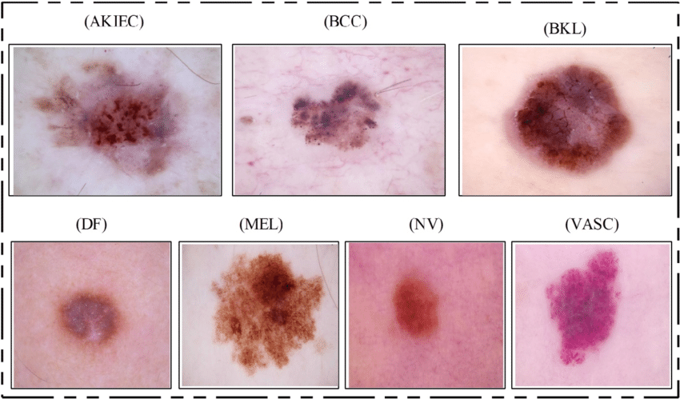
RESULTS
In this study using random regulators, the CNN procedure gave an accuracy of 97.49%. It is able to differentiate some skin lesions like melanoma, carcinoma and nevus lesions. This study uses augmentation data from the HAM10000 dataset. This dataset is used to differentiate between skin cancer lesions or benign cancer.Thus it classifies the skin cancer effectively.
10

